Slide 1
Hypervisor Architectures & VMMs

Slide 2
Learning Outcomes
LO 3 : Application: Apply programmatic interfaces and control plane automation tools to provision, configure, and manage the lifecycle of virtualized resources.
LO 3 : Analyze system requirements to identify actors, processes, data, and interactions
LO 4 : Apply UML-based design artifacts to communicate a complete system solution

Slide 3
Outline
Monolithic vs. Microkernel Hypervisors
Type-1 vs. Type-2 Hypervisors
Case Studies: KVM, Xen, and ESXi

Slide 4
Monolithic vs. Microkernel Hypervisors

Slide 5
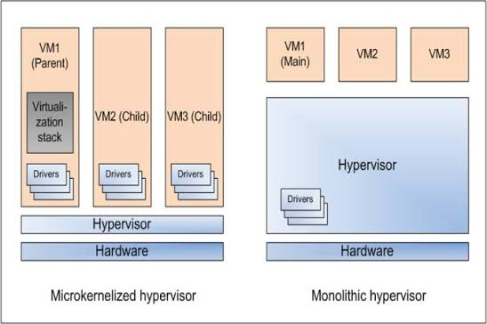
Monolithic vs. Microkernel Hypervisors
Monolithic Hypervisor
Most virtualization services run inside the hypervisor
Often includes device drivers in the hypervisor layer
Provides direct control over hardware resources
Usually delivers strong performance
Larger internal code base may reduce isolation
Image retreived from https://www.researchgate.net/figure/Monolithic-hypervisor-and-Microkernelized-hypervisor_fig2_272778941
Notes:
A monolithic hypervisor integrates many virtualization services directly into the hypervisor layer. This often includes device drivers and core resource management functions. Because more services are placed inside the hypervisor, performance can be very efficient. However, this approach may also increase complexity and reduce isolation if one internal component has a problem.

Slide 6
Monolithic vs. Microkernel Hypervisors
Microkernel Hypervisor
Keeps only essential functions in the hypervisor core
Moves other services outside the core
Device drivers may run in separate components
Improves modularity and fault isolation
May introduce additional communication overhead
Image retreived from https://www.researchgate.net/figure/Monolithic-hypervisor-and-Microkernelized-hypervisor_fig2_272778941
Notes:
A microkernel hypervisor keeps the hypervisor core as small as possible. Only essential functions remain in the core, while other services such as drivers or management components are separated outside it. This improves modularity and makes the system easier to isolate and maintain. The trade-off is that communication between components may introduce some additional overhead.

Slide 7
Monolithic vs. Microkernel Hypervisors
Comparison
Monolithic Hypervisor | Microkernel Hypervisor
Runs many services inside the hypervisor | Keeps only essential services in the core
Often includes device drivers in the hypervisor layer | Moves drivers and services outside the core
Usually offers high performance | Usually offers better modularity and isolation
Simpler internal communication | Requires communication between separate components
Larger code base inside the hypervisor | Smaller hypervisor core
Notes:
Monolithic and microkernel hypervisors differ mainly in how they organize services and drivers. Monolithic hypervisors keep more functionality inside the hypervisor, which can improve performance. Microkernel hypervisors keep the core smaller and separate supporting services, which improves modularity and isolation.

Slide 8
Type-1 vs. Type-2 Hypervisors

Slide 9
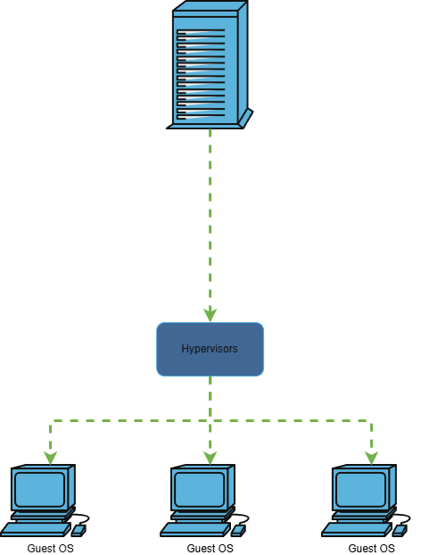
Type-1 vs. Type-2 Hypervisors
Type-1 Hypervisor
Runs directly on physical hardware
Also called a bare-metal hypervisor
Does not require a host operating system
Provides strong performance and isolation
Common in data centers and cloud infrastructure
Hypervisors
Guest VM
Guest VM
Guest VM
Notes:
A Type-1 hypervisor runs directly on physical hardware. Because it does not depend on a host operating system, it usually provides better performance, stronger isolation, and more direct control over hardware resources. This model is commonly used in enterprise data centers and cloud environments.

Slide 10
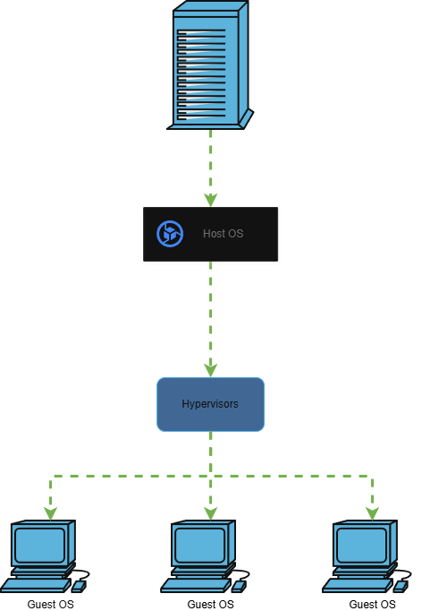
Type-1 vs. Type-2 Hypervisors
Type-2 Hypervisor
Runs on top of a host operating system
Also called a hosted hypervisor
Uses host OS drivers and services
Easier to install and use
Common for desktop virtualization and testing
Hypervisors
Guest VM
Guest VM
Guest VM
Notes:
A Type-2 hypervisor runs as an application on top of a host operating system. It is usually easier to install and manage because it can use the host OS drivers and services. However, it may have more overhead compared to Type-1 hypervisors because I/O and hardware access pass through the host OS.

Slide 11
Type-1 vs. Type-2 Hypervisors
Comparison
Type-1 Hypervisor | Type-2 Hypervisor
Runs directly on hardware | Runs on top of a host OS
Also called bare-metal | Also called hosted
Better performance and isolation | Easier to install and use
Used in data centers and cloud | Used for desktop labs and testing
Examples: ESXi, Xen, Hyper-V, KVM | Examples: VirtualBox, VMware Workstation, Parallels
Notes:
The key difference is where the hypervisor runs. Type-1 hypervisors run directly on hardware and are commonly used for production virtualization. Type-2 hypervisors run on top of a host operating system and are more common for learning, testing, and desktop virtualization.

Slide 12
Case Studies: KVM, Xen, and ESXi

Slide 13
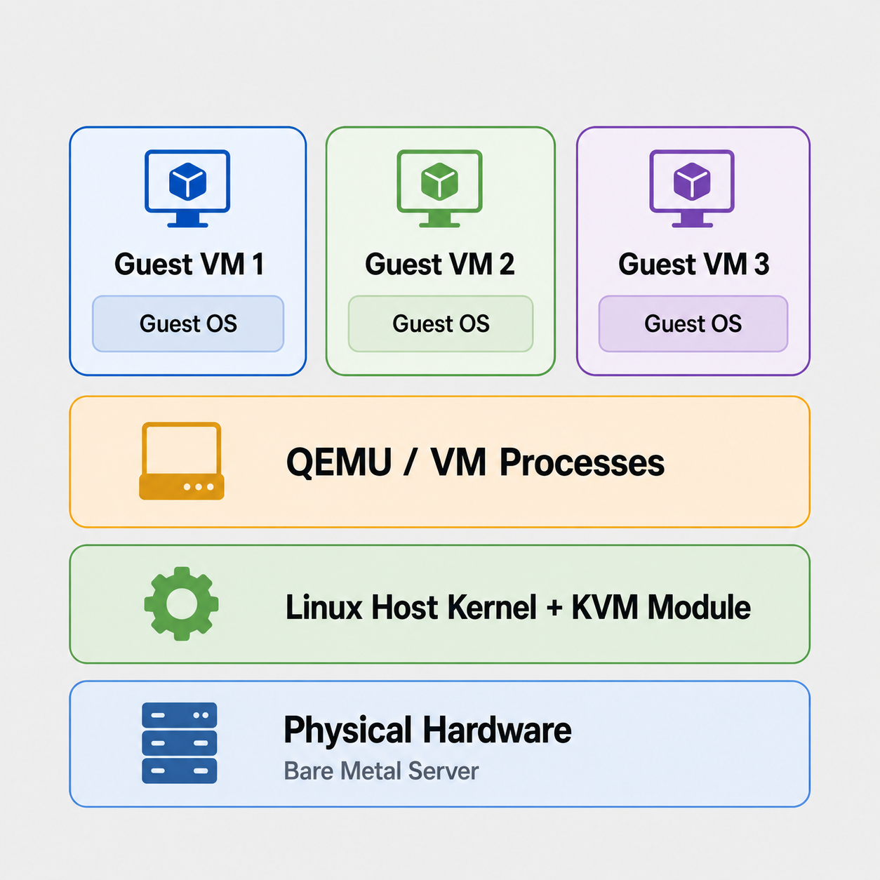
Case Studies: KVM, Xen, and ESXi
KVM
Linux-based virtualization technology
Turns the Linux kernel into a hypervisor
Commonly works with QEMU for device emulation
Supports hardware-assisted virtualization
Widely used in cloud and open-source platforms
KVM is commonly used in open-source cloud platforms such as OpenStack. It is suitable for organizations that want scalable virtualization using Linux-based infrastructure.
Notes:
KVM, or Kernel-based Virtual Machine, is built into the Linux kernel. It allows Linux to function as a hypervisor and is commonly combined with QEMU to provide complete virtualization support. KVM is widely used in open-source virtualization and cloud infrastructure.

Slide 14
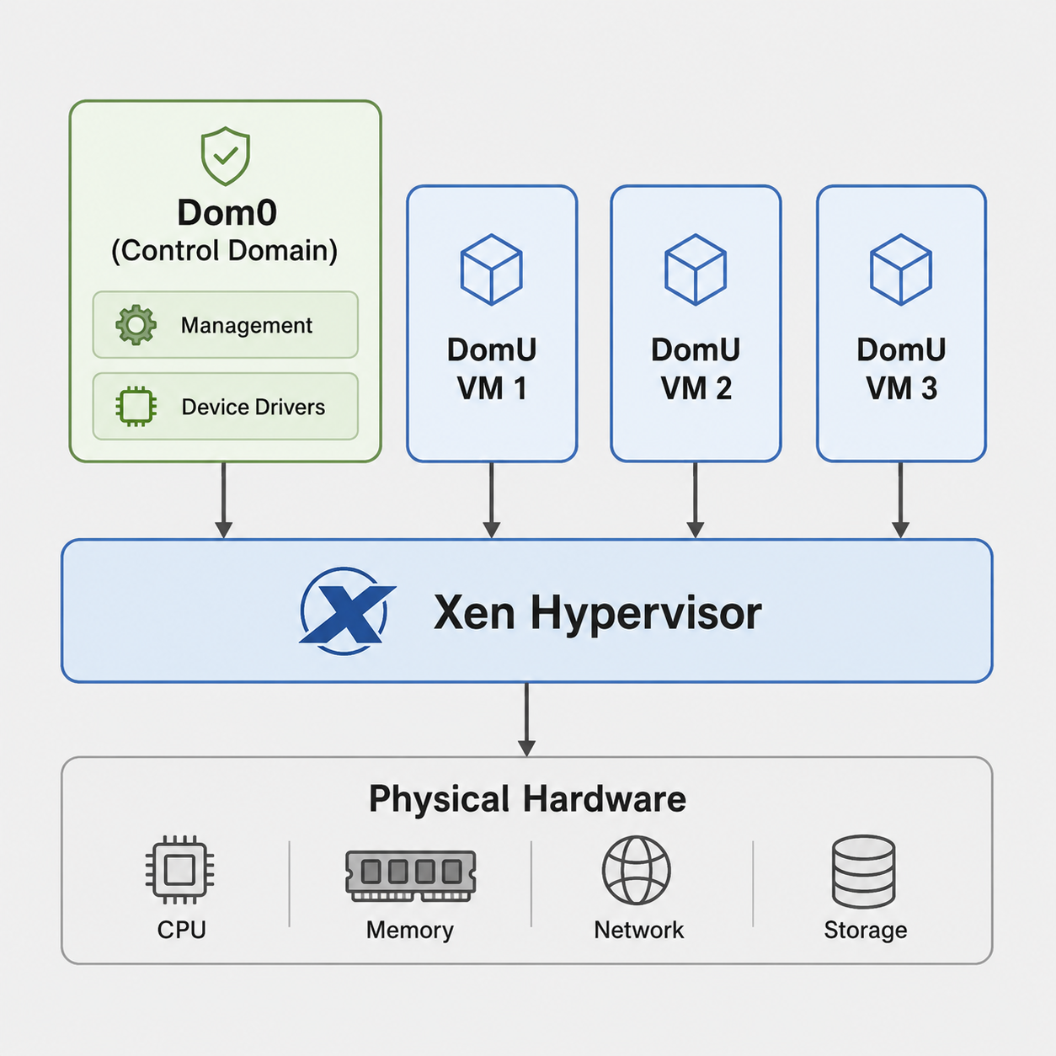
Case Studies: KVM, Xen, and ESXi
XEN
Type-1 hypervisor architecture
Uses Dom0 as the control domain
Runs guest VMs as DomU
Dom0 manages hardware access and VM control
Known for isolation and cloud virtualization use
Xen is often used in cloud environments that require strong isolation between virtual machines. Its Dom0/DomU model separates the control domain from guest workloads.
Notes:
Xen uses a domain-based architecture. Dom0 is a privileged control domain that manages hardware access and controls other guest domains. Guest virtual machines run as DomU. This architecture separates management responsibilities from guest workloads.

Slide 15
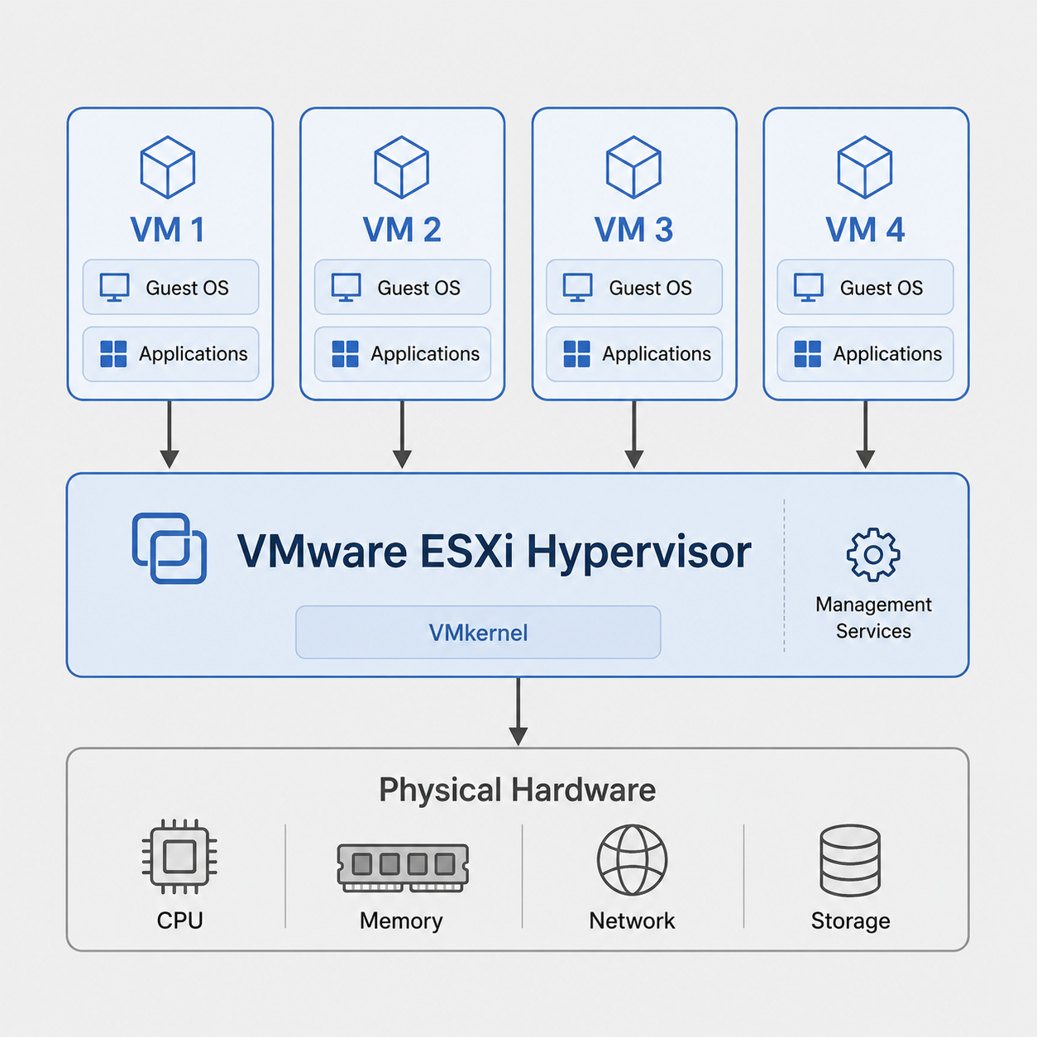
Case Studies: KVM, Xen, and ESXi
VMware ESXi
Enterprise bare-metal hypervisor
Runs directly on physical servers
Designed for data center virtualization
Provides centralized VM management with VMware tools
Common in enterprise private cloud environments
ESXi is commonly used in enterprise data centers and private cloud environments. Companies use it to consolidate many business servers into fewer physical machines with centralized management.
Notes:
VMware ESXi is a bare-metal hypervisor used widely in enterprise data centers. It runs directly on physical servers and provides strong virtualization performance, isolation, and management features. ESXi is commonly used together with VMware management tools for large-scale virtual infrastructure.

Slide 16
Case Studies: KVM, Xen, and ESXi
Comparison
KVM | Xen | ESXi
Linux-based | Type-1 hypervisor | Enterprise bare-metal
Uses Linux kernel | Uses Dom0/DomU model | VMware ecosystem
Often paired with QEMU | Strong isolation model | Strong management tools
Open-source cloud use | Cloud and research use | Enterprise data centers
Common in OpenStack and Linux clouds | Used for isolated cloud workloads | Common in enterprise private clouds
Notes:
The key difference is where the hypervisor runs. Type-1 hypervisors run directly on hardware and are commonly used for production virtualization. Type-2 hypervisors run on top of a host operating system and are more common for learning, testing, and desktop virtualization.

Slide 17
Exercise
The Architectural Gap
A Type 1 hypervisor runs directly on the bare-metal hardware, whereas a Type 2 hypervisor runs as an application on top of a host Operating System (e.g., Windows or Linux).
Question: When a Guest OS inside a Type 2 VM executes an I/O operation (like writing a file to disk), why does it experience a longer latency path compared to the same operation running on a Type 1 hypervisor?

Slide 18
References
Amazon Web Services. (n.d.). The difference between Type 1 and Type 2 hypervisors. Retrieved June 20, 2026, from https://aws.amazon.com/id/compare/the-difference-between-type-1-and-type-2-hypervisors/
Erl, T., & Barceló Monroy, E. (2024). Cloud computing: Concepts, technology, security, and architecture (2nd ed.). Pearson.
GeeksforGeeks. (2025, December 5). Microkernel vs. monolithic kernel. https://www.geeksforgeeks.org/operating-systems/difference-between-microkernel-and-monolithic-kernel/
Katzer, J. (2021). Learning serverless: Design, develop, and deploy with confidence. O’Reilly Media.
Marinescu, D. C. (2022). Cloud computing: Theory and practice (3rd ed.). Morgan Kaufmann.
Xen Project. (n.d.). Xen Project: Open source virtualization. Retrieved June 20, 2026, from https://xenproject.org/
Notes:
VMware ESXi is a bare-metal hypervisor used widely in enterprise data centers. It runs directly on physical servers and provides strong virtualization performance, isolation, and management features. ESXi is commonly used together with VMware management tools for large-scale virtual infrastructure.

